Slide 1
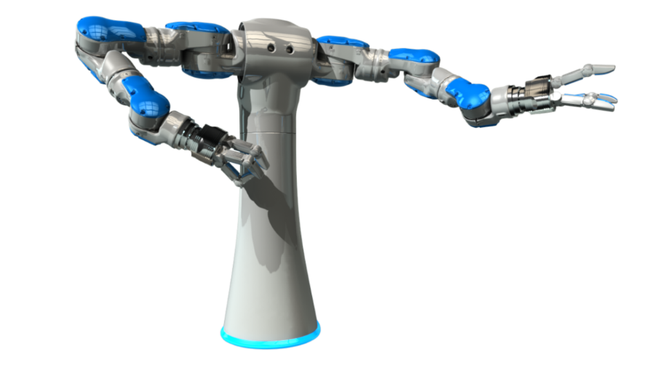
3d Printing
Hackid 2014
Join the Maker Society
Intro Course

Slide 2
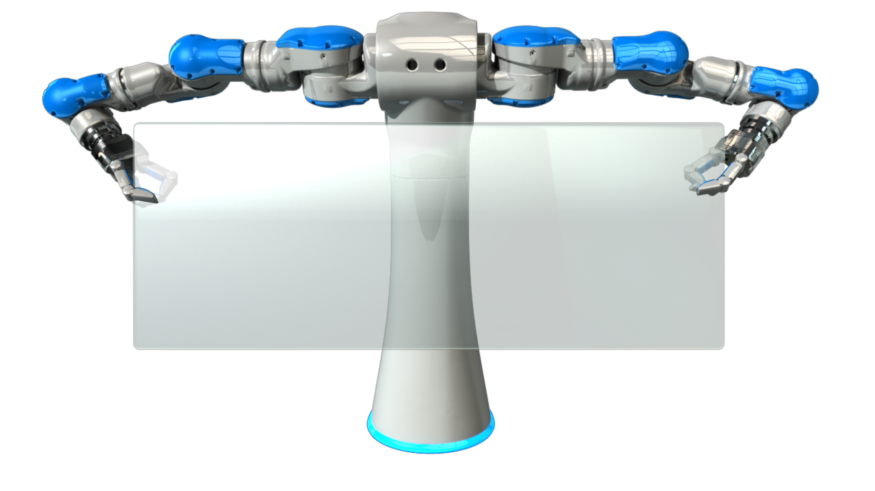
Why 3d Printing?
.

Slide 3
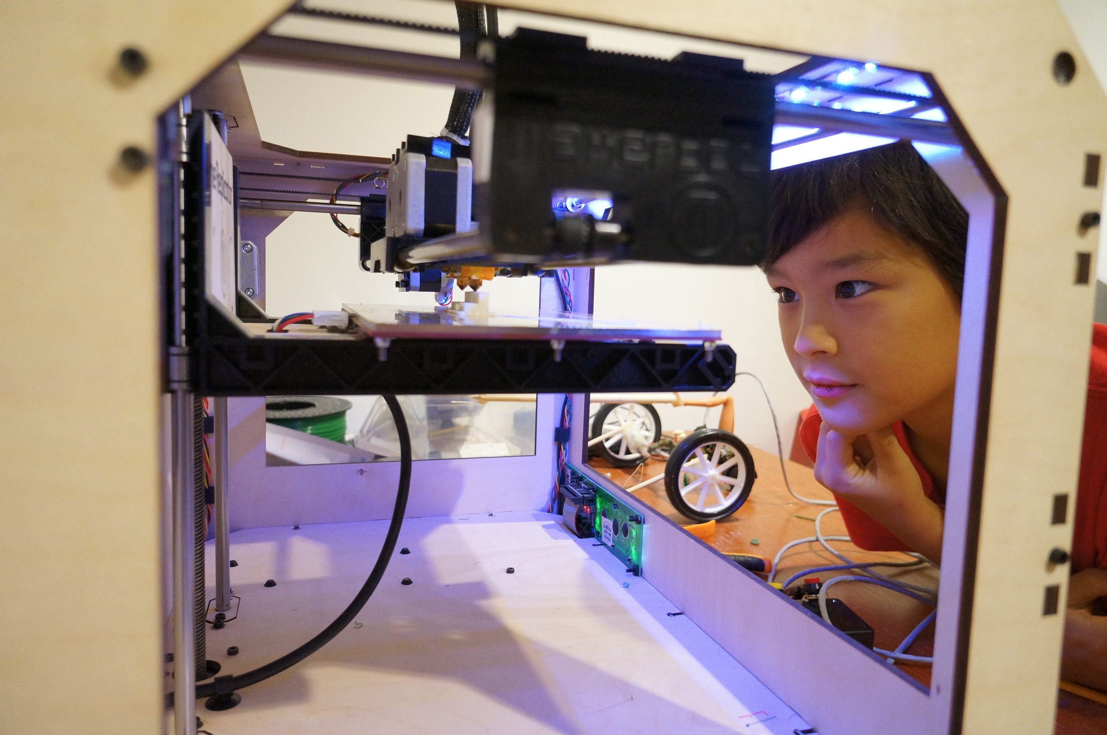
Notes:
Stuff with my kids

Slide 4
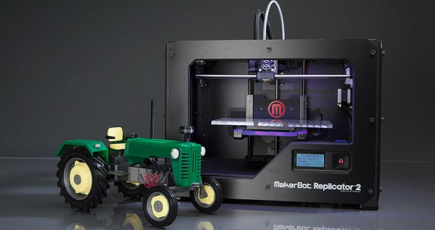
You can MAKE TOYS!!

Slide 5
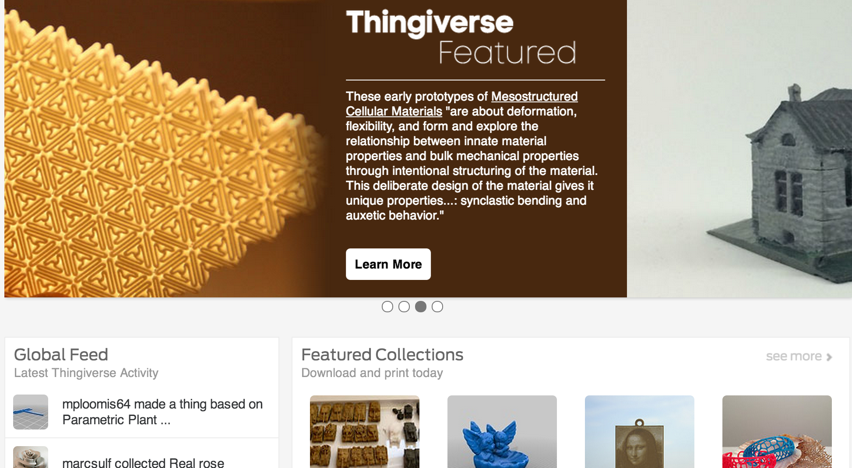
Objects - 3d Printing Communties

Slide 6
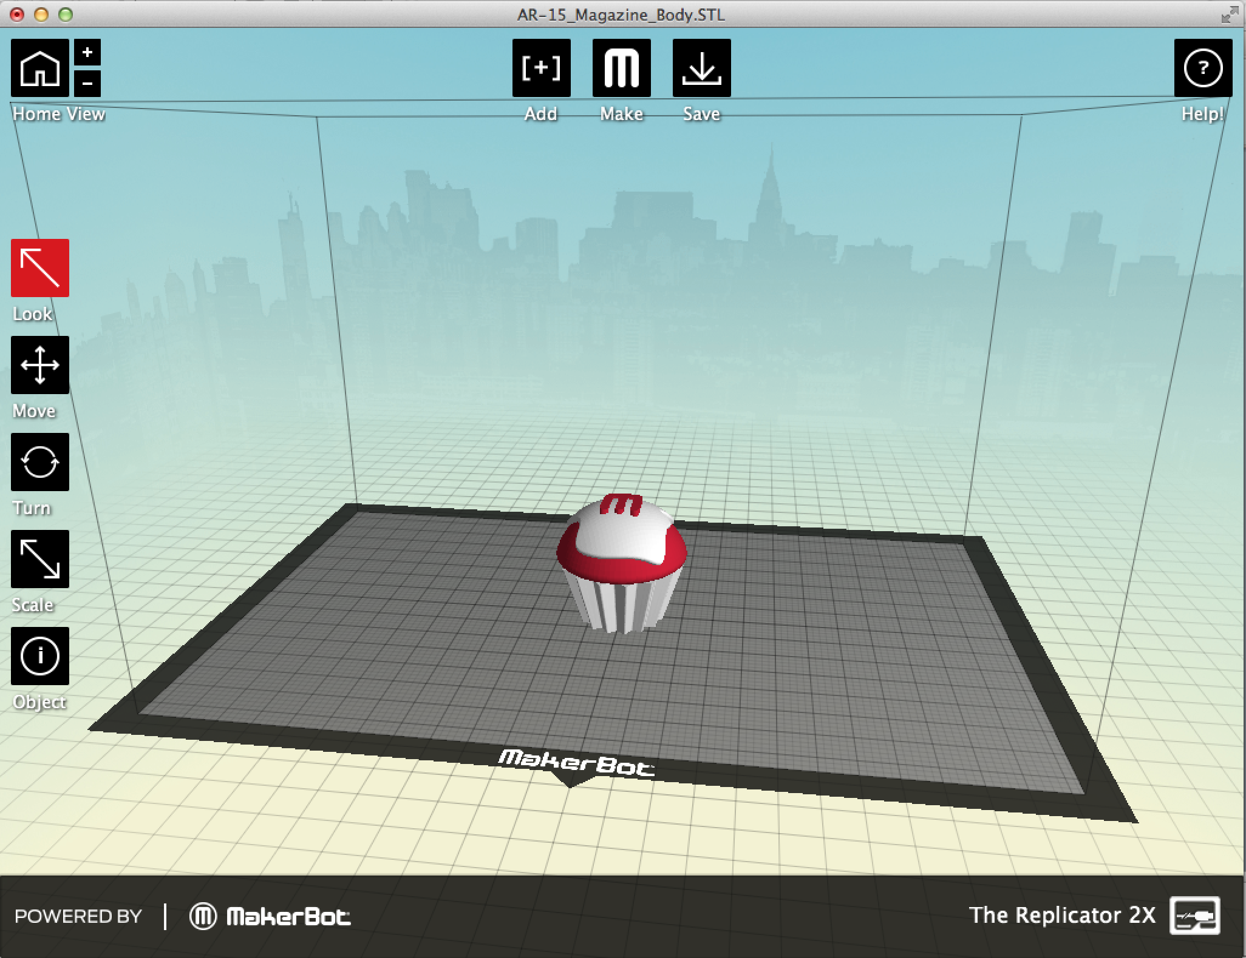
Makerware

Slide 7
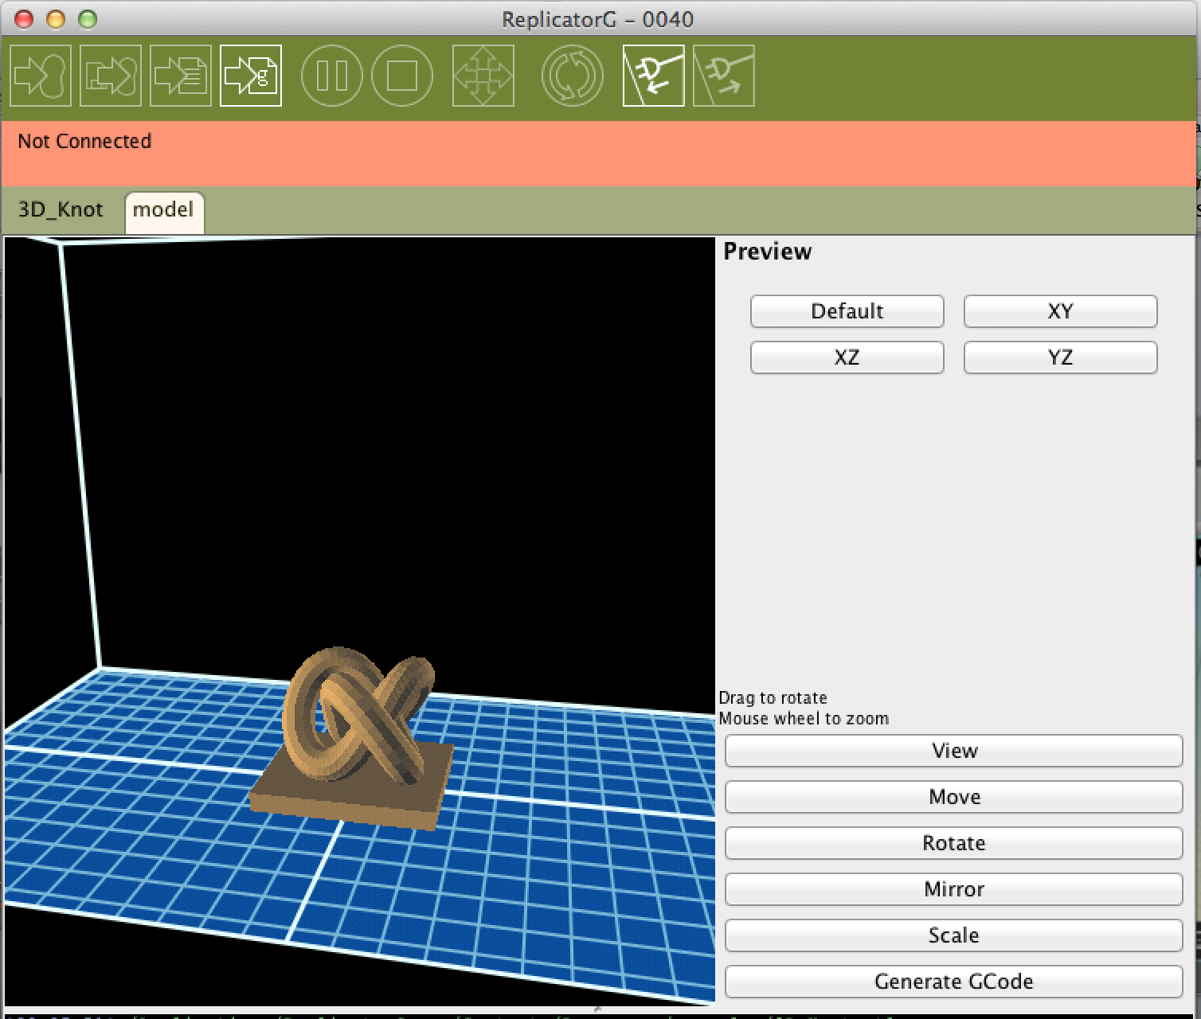
Replicator G

Slide 8
3D Software Demo
.

Slide 9
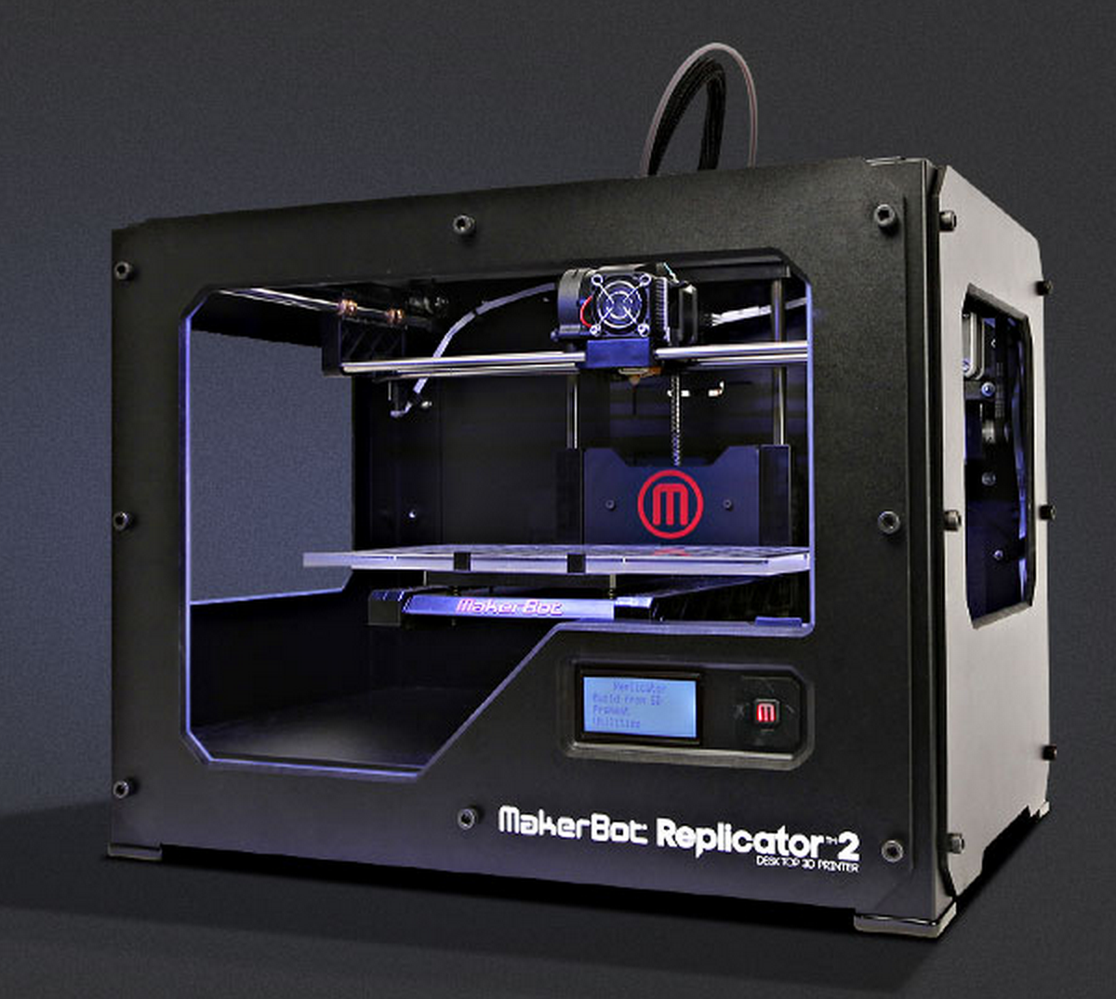
3d Printing Hardware
Makerbot
Replicator
Reprap
Creator

Slide 10
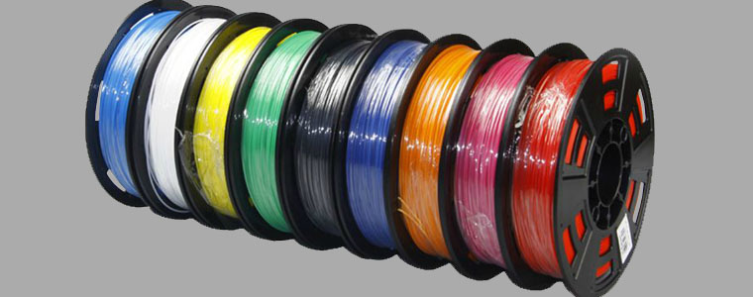
Filiment
Thin Platic Spools
ABS - Plastic
PLA – Potato
Disolvable!!!

Slide 11
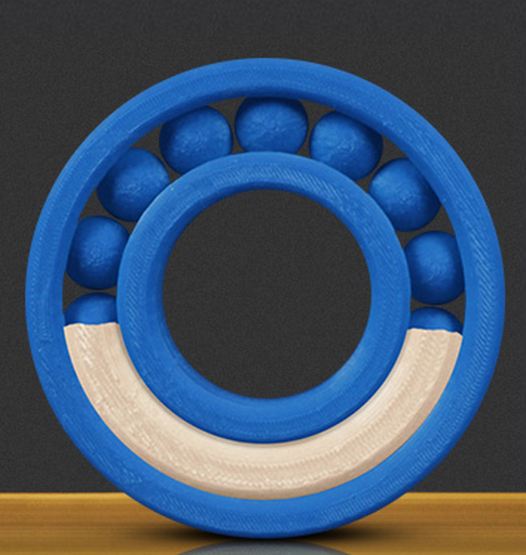
Dissolvable filament!

Slide 12
How the 3d Printer works – Use Camera
Platform
Steppers
Extruder
Map

Slide 13
ACTIVITY TIME!

Slide 14
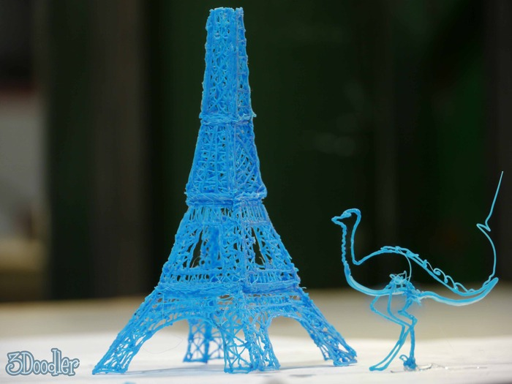
ACTIVITY ---- 3doodler - Print your own object by hand!

Slide 15

Questions? More Information?
www.makerbot.com
@COLINMCNAMARA

Slide 16
3d Printing
Hackid 2014
Join the Maker Society
Advanced Course

Slide 17
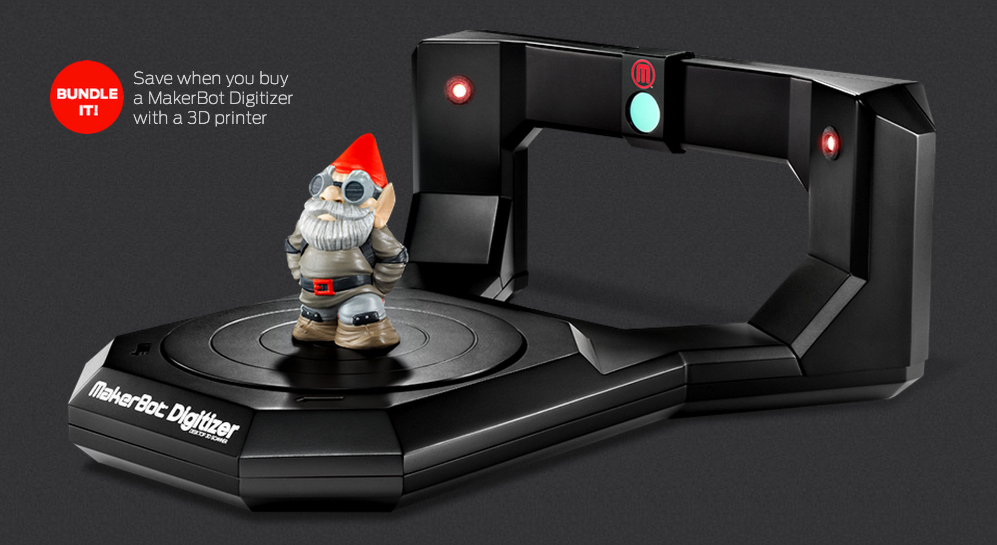
3d Scanners

Slide 18
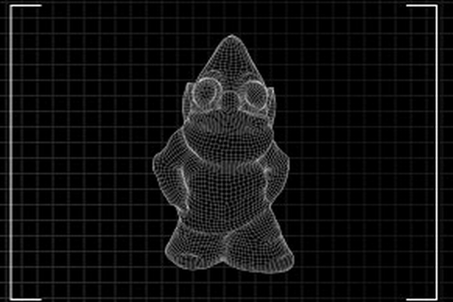
Creating a new one - Scanning!

Slide 19
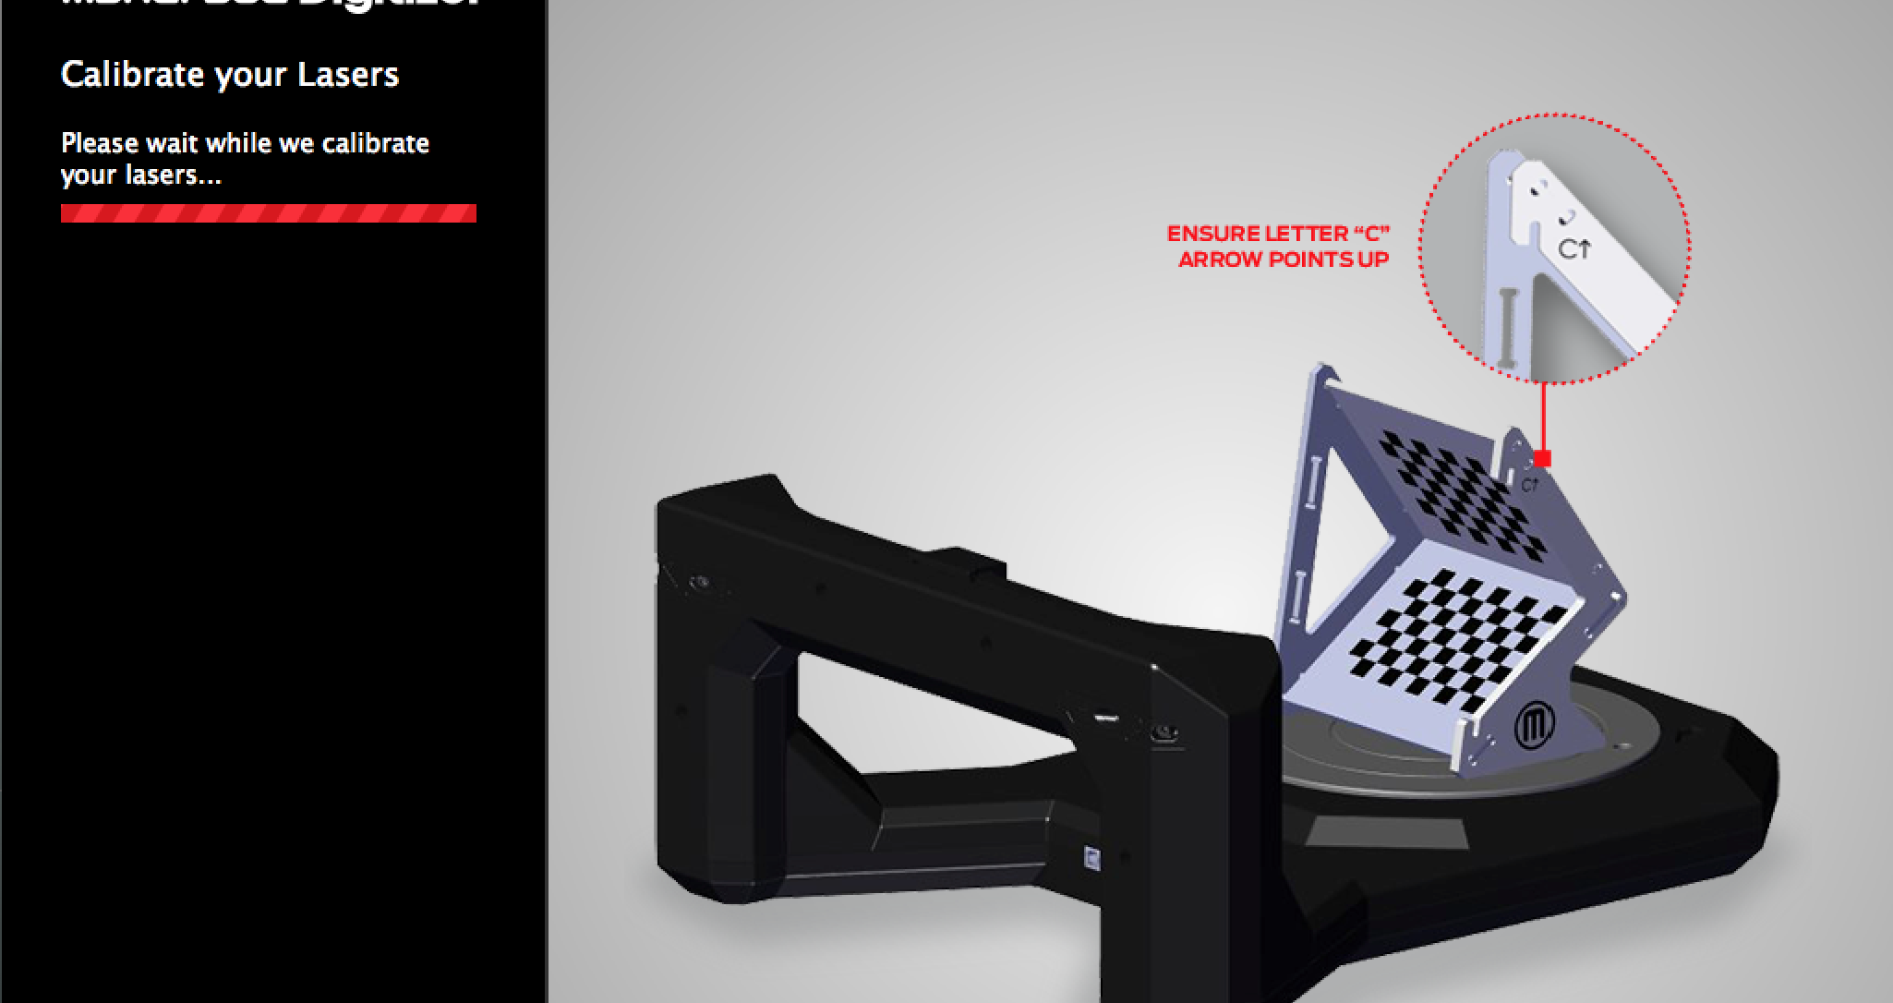
Calibration

Slide 20
DEMO! – SCAN STUFF!!!
.

Slide 21
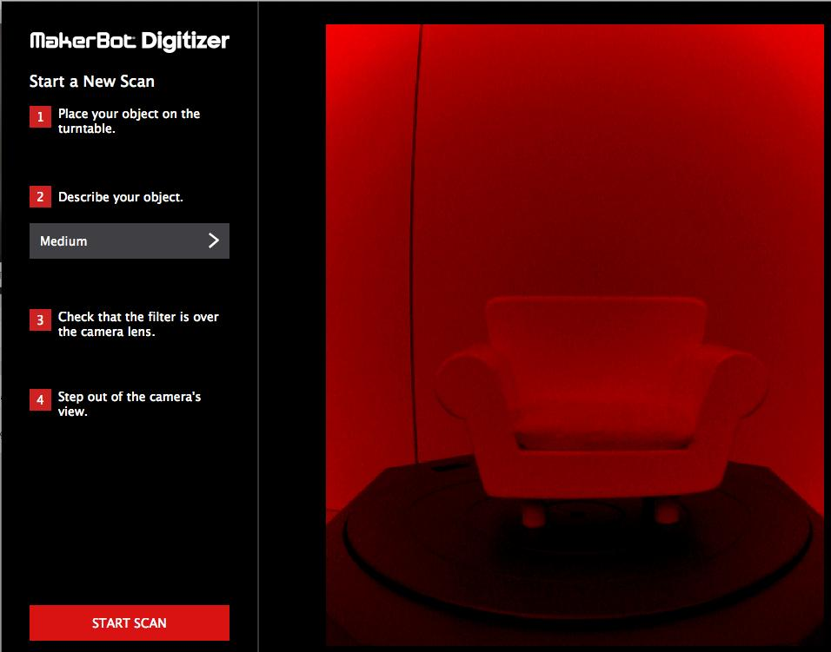
Scanning

Slide 22
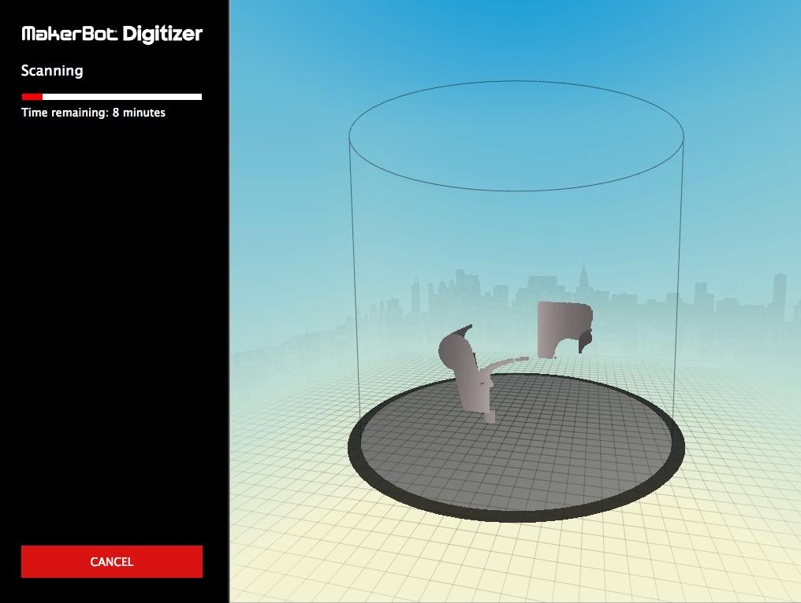
Lasers building a 3d picture

Slide 23
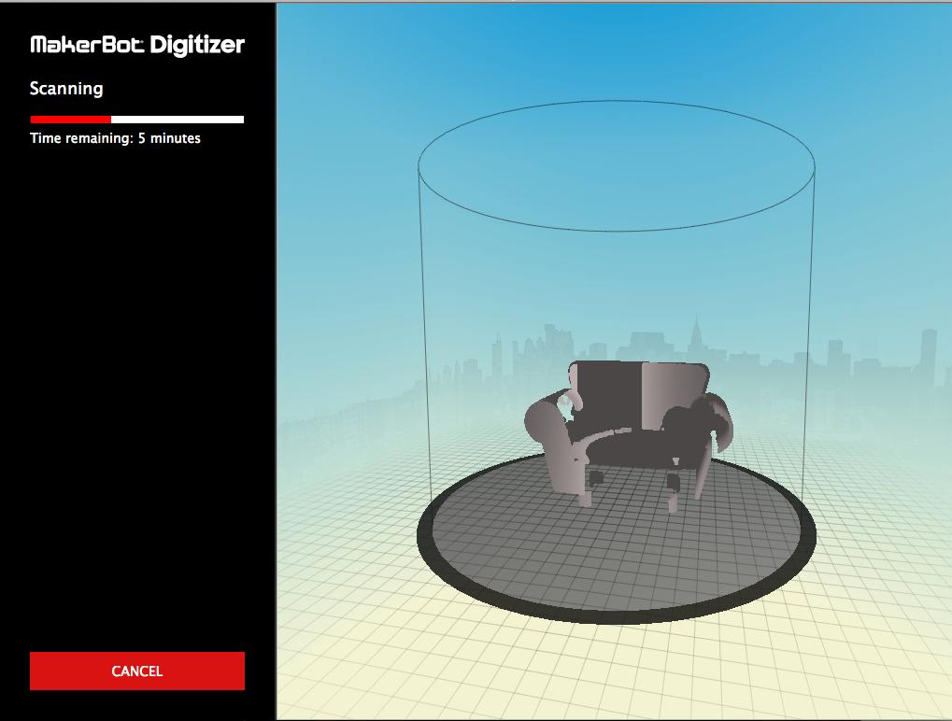
Building a better picture

Slide 25
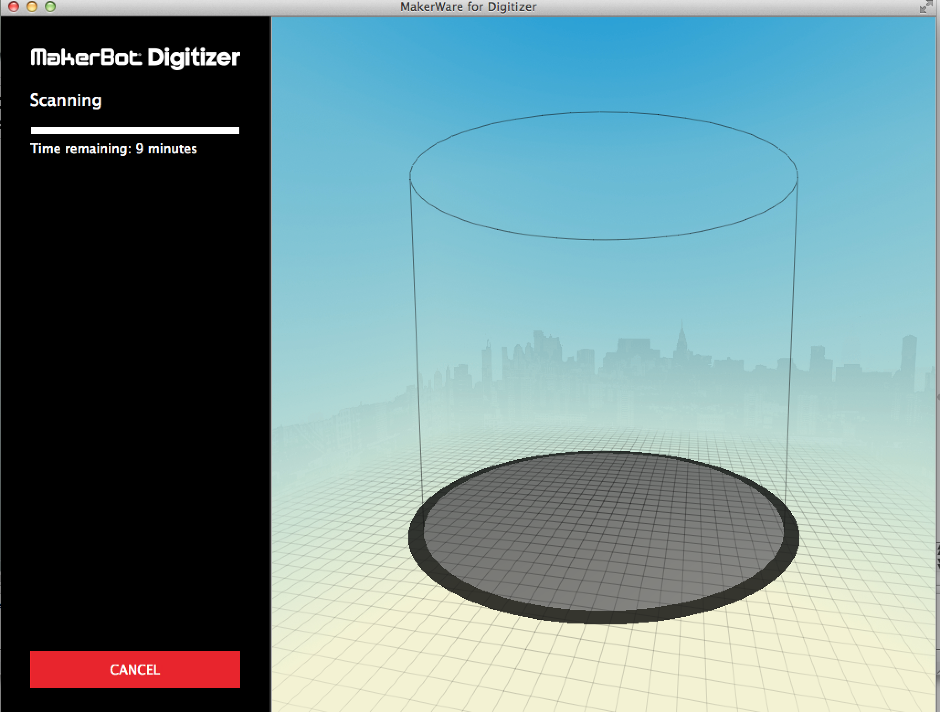
Scanning item!

Slide 26
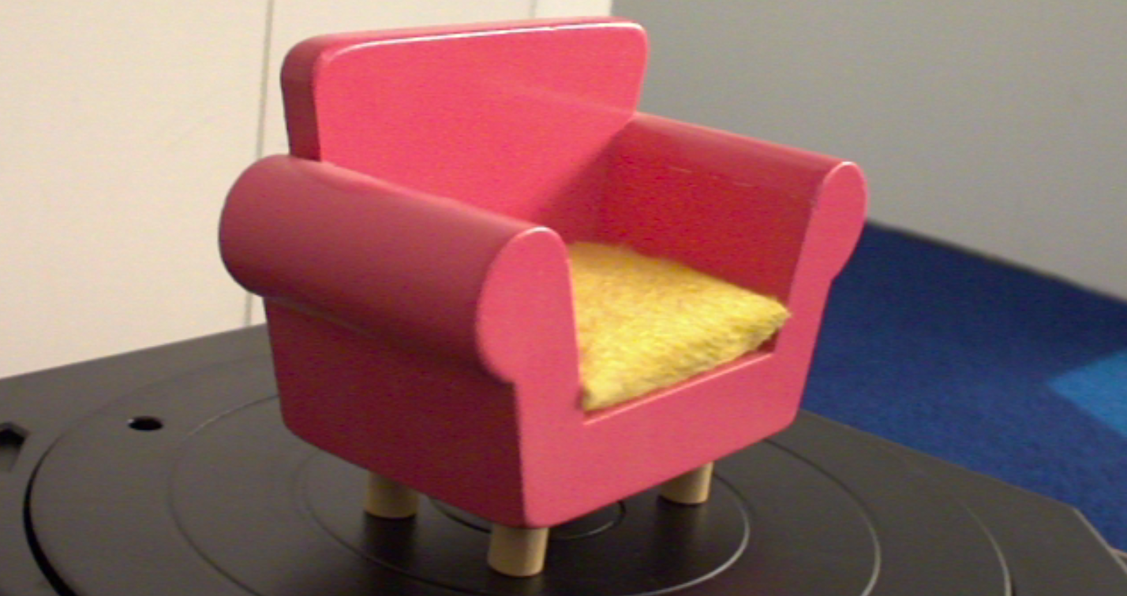
What we are scanning

Slide 27
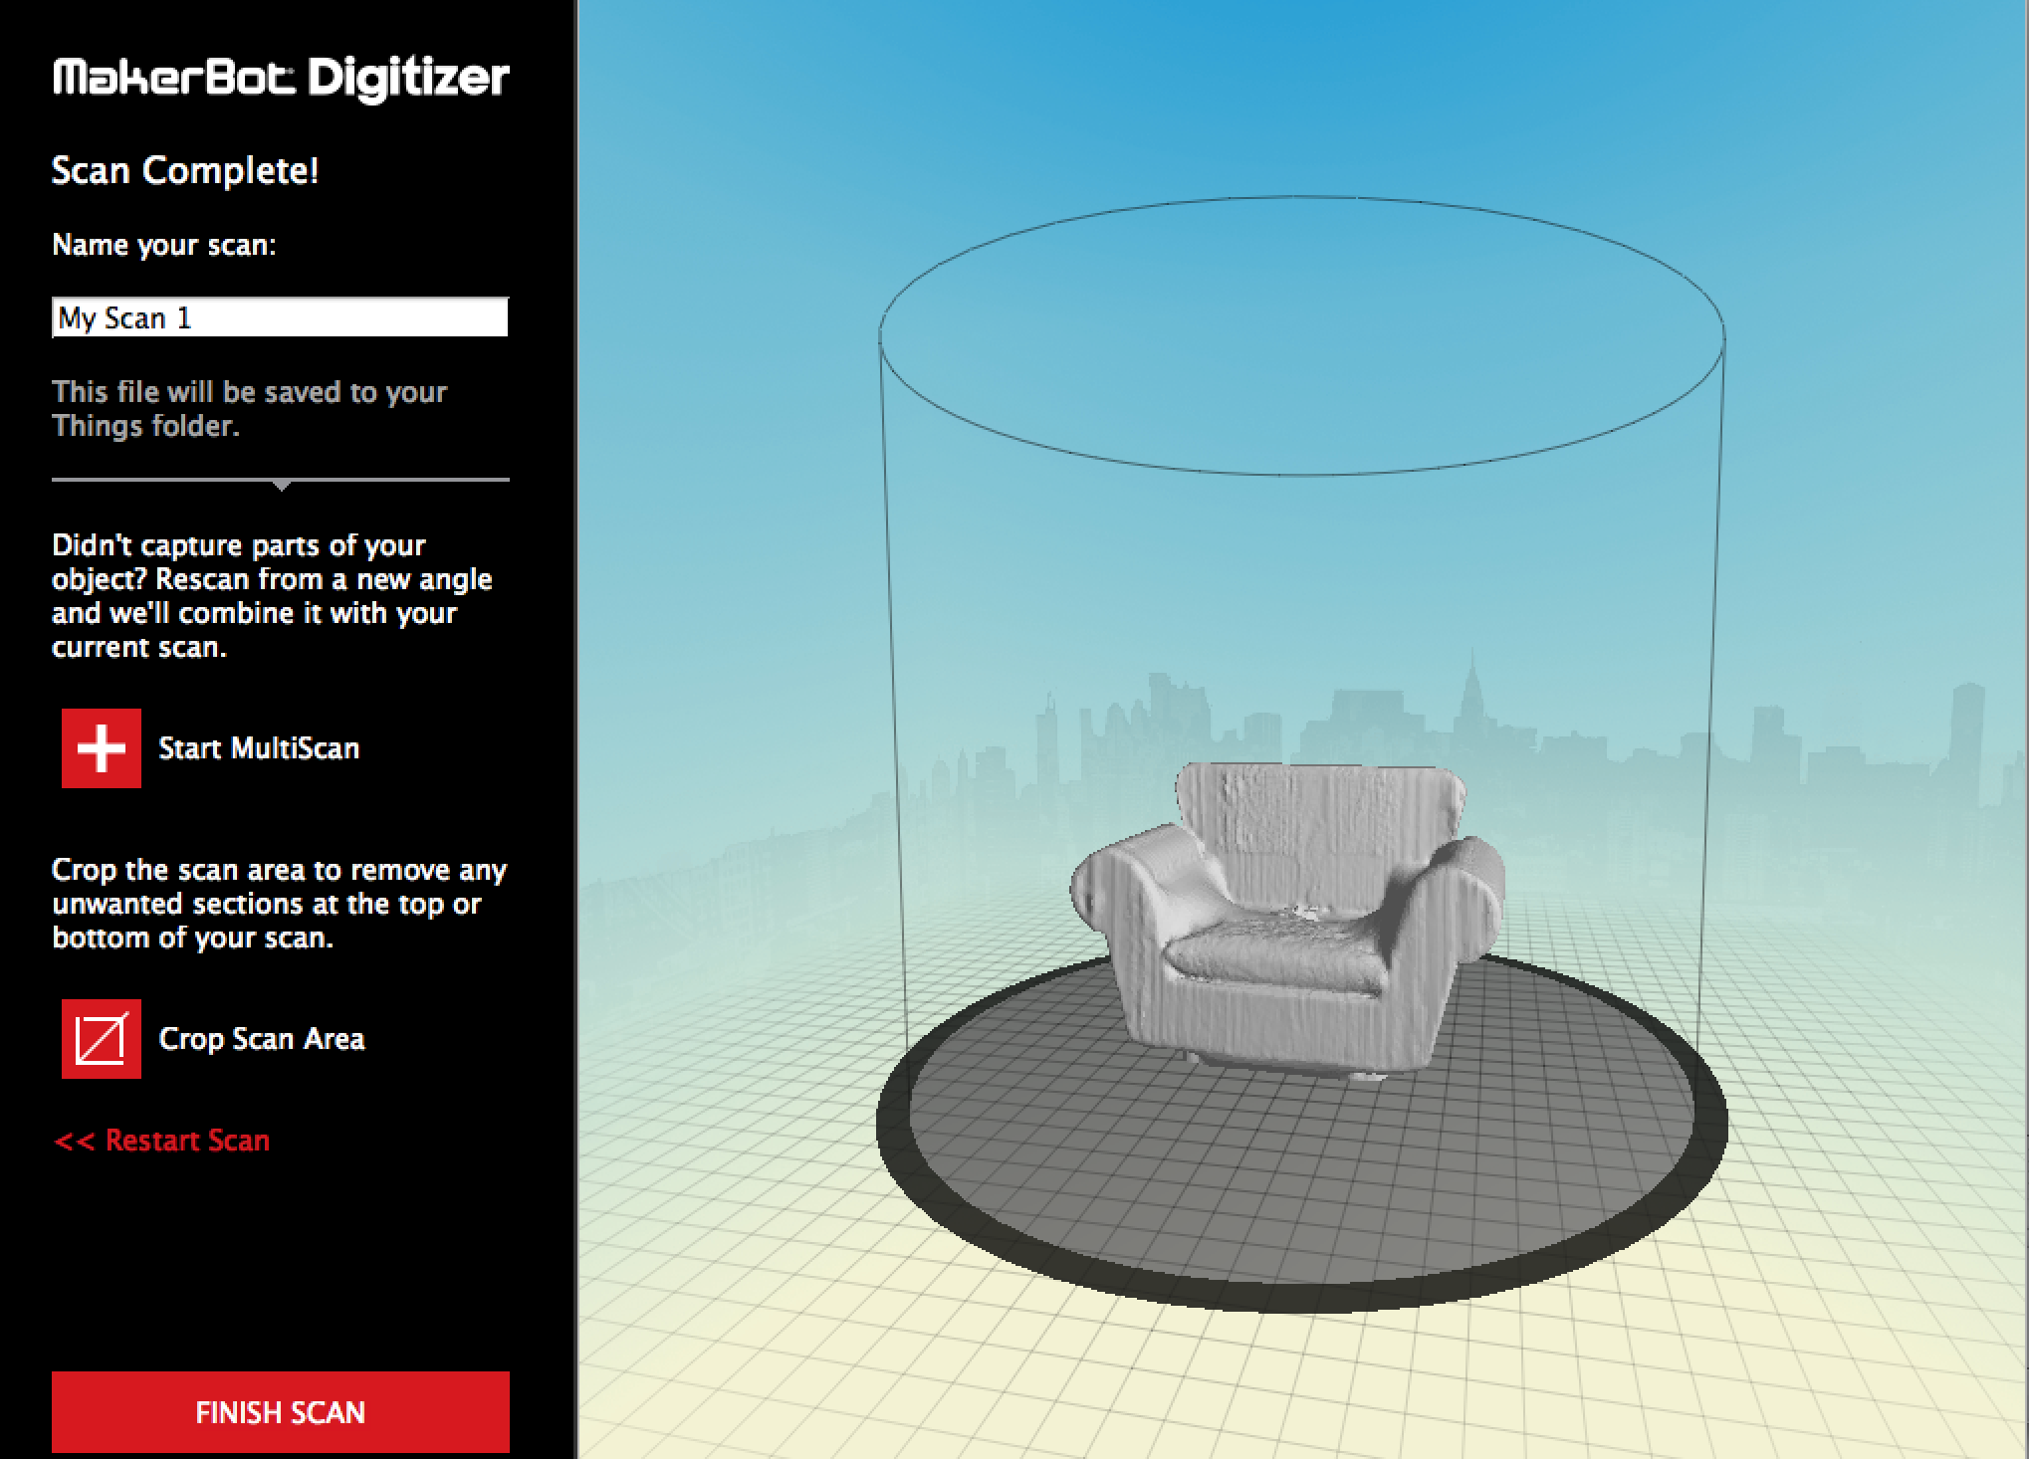
Look it’s a COUCH!

Slide 28
DEMO! Customize!
.

Slide 29
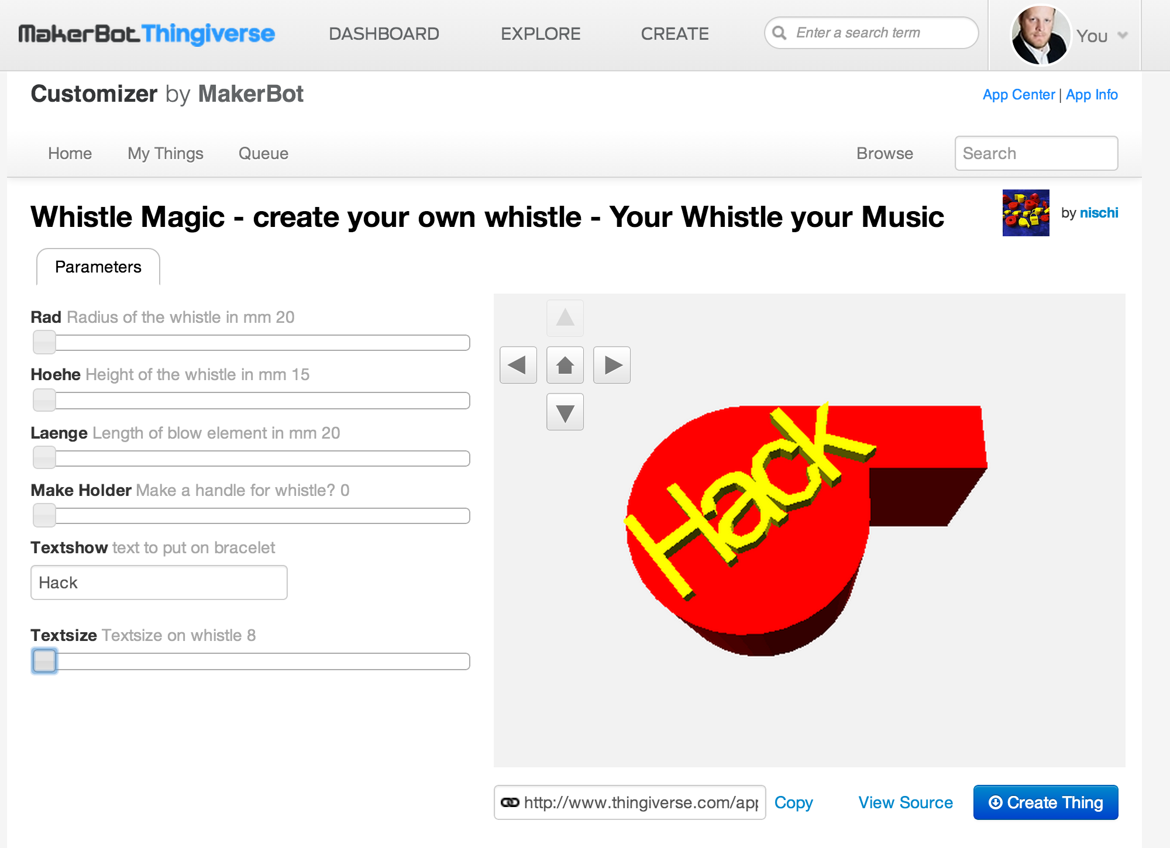
Customizing your model

Slide 30
DEMO! Acetone Immersion
.

Slide 31
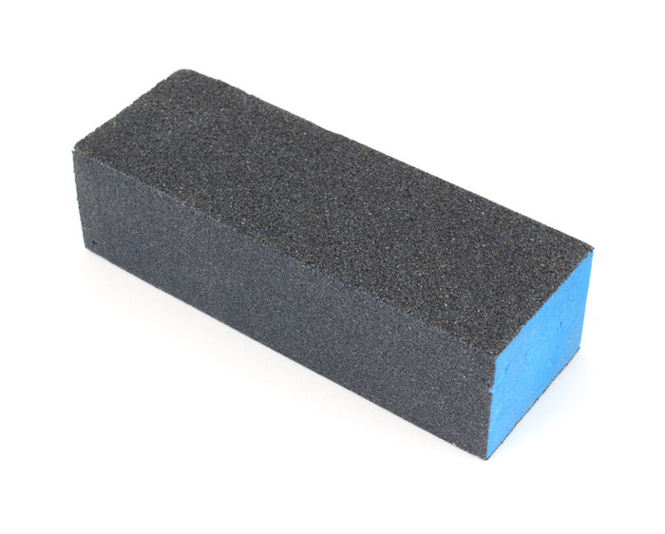
smoothing your object
Sanding
Tools - knifes

Slide 32
DEMO! – Acetone Immersion
.

Slide 33
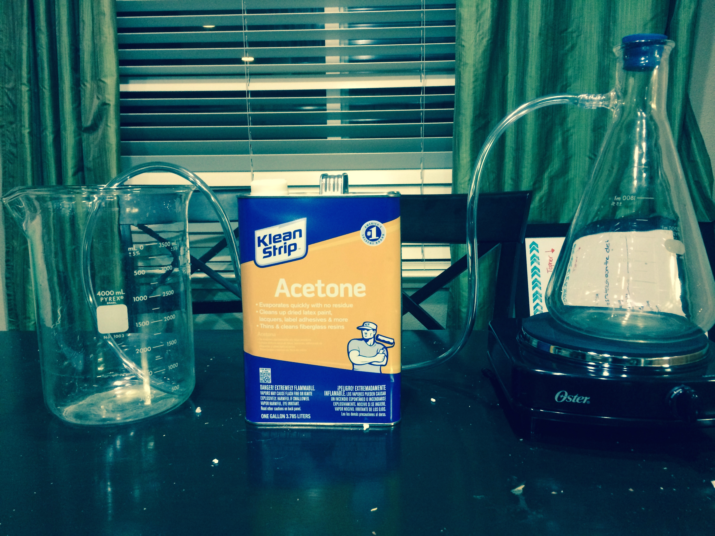
Acetone Immersion

Slide 34
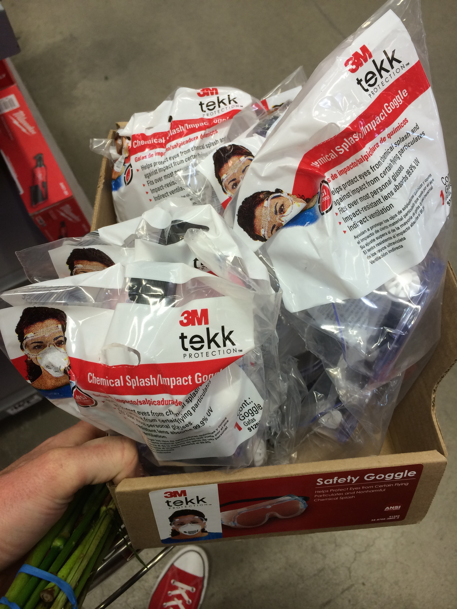
SAFETY
Fire
Eye Protection
Parents

Slide 35
Theory
Melting Face

Slide 36
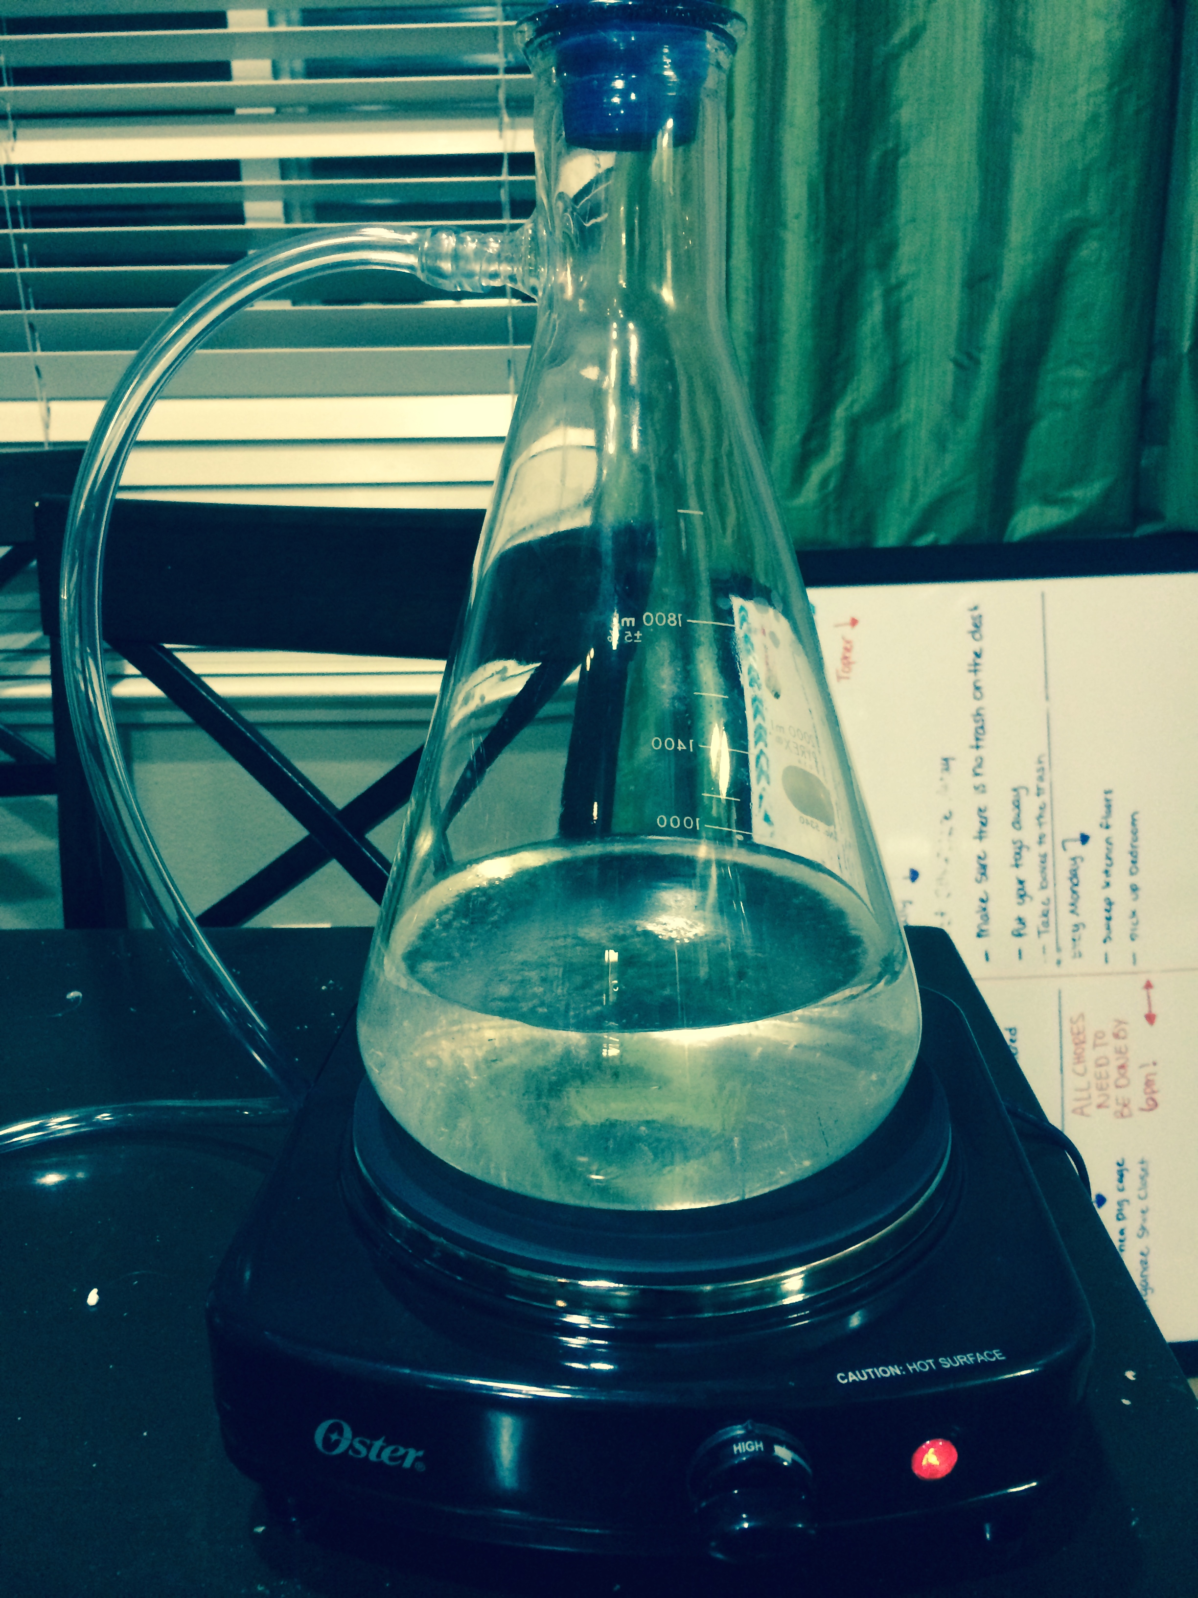
Parts
Flask
Tube
Hotplate

Slide 37
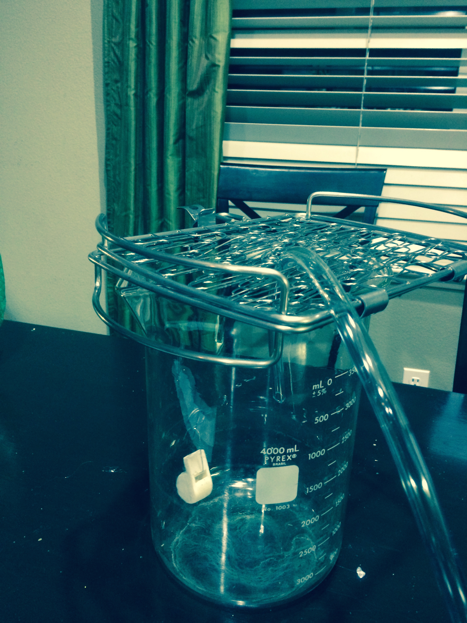
Parts
Container
Wire hooks (christmas)
Metal Grid

Slide 38
Learn More!
www.hackerspaces.org
http://hackerspaces.org/wiki/Sudo_room - Oakland
http://hackerspaces.org/wiki/HackerDojo - Mountain View
http://hackerspaces.org/wiki/Noisebridge - San Francisco
http://hackerspaces.org/wiki/East_Bay_Maker_Labs San Leandro

